Slide 1
Project Overview
Dr. Steven Swanson
CSE176e/276e
swanson@cs.ucsd.edu

Slide 2
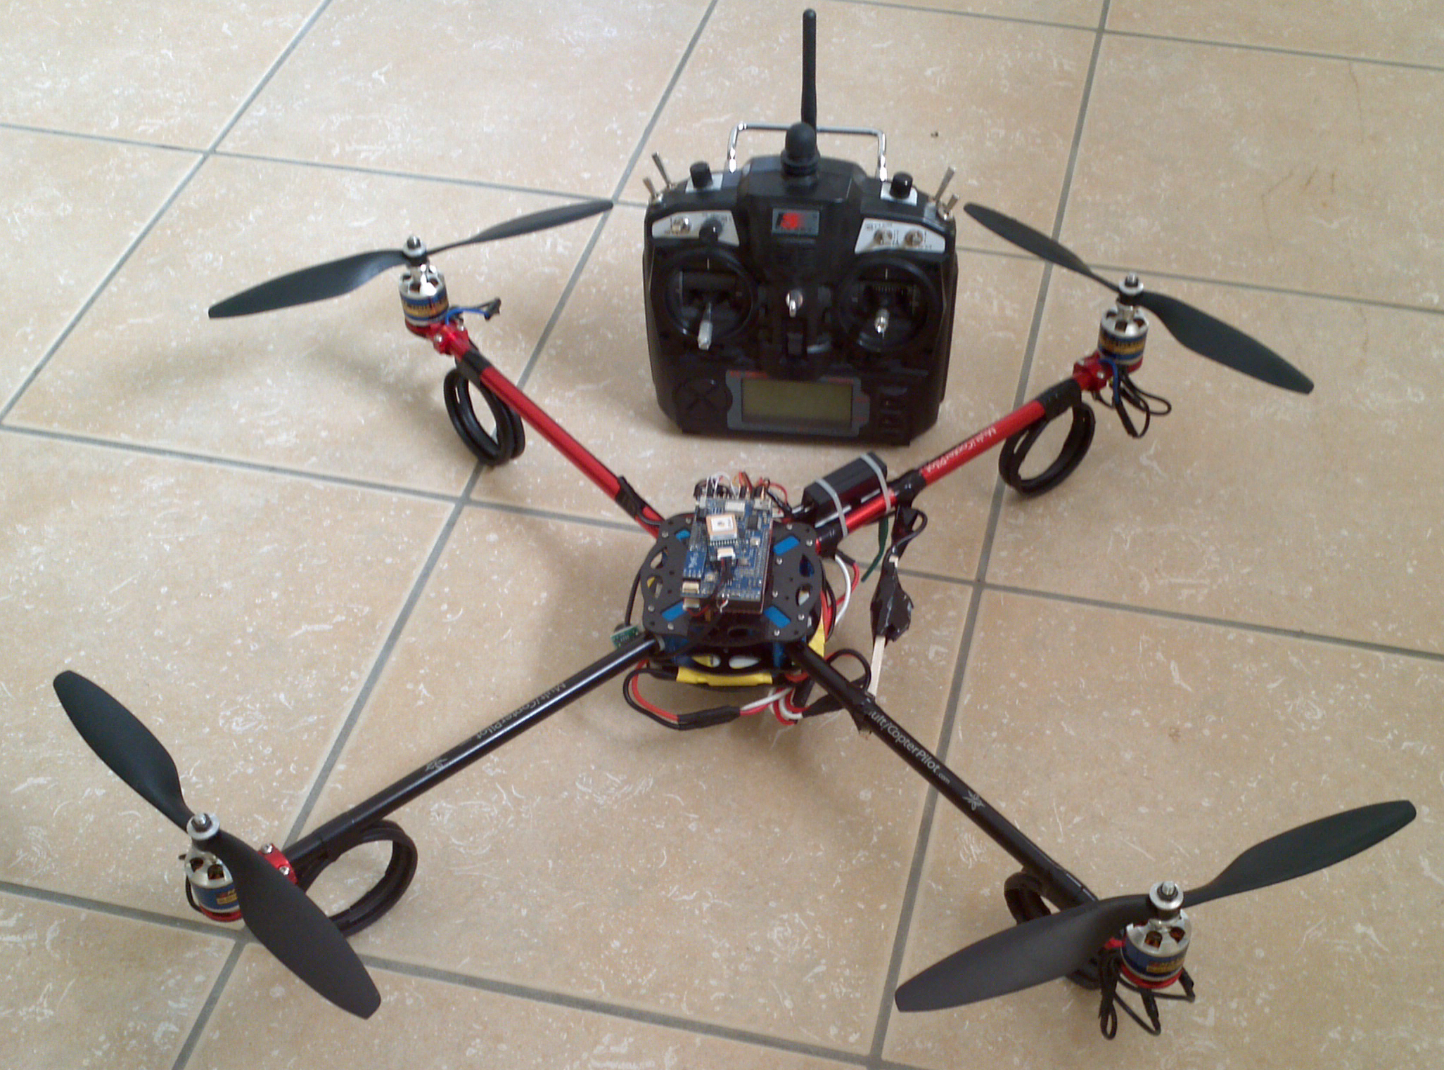
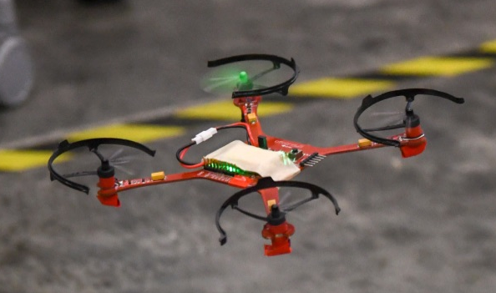
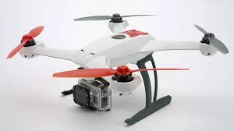
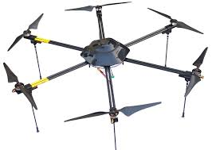
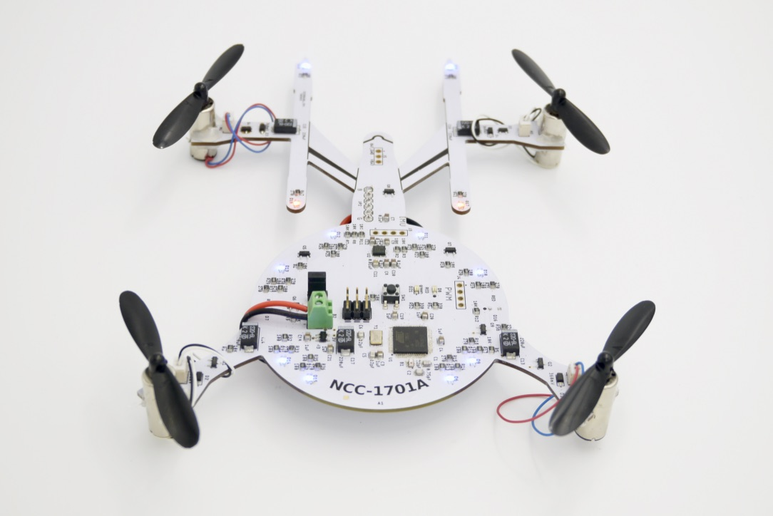
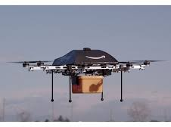

Slide 3
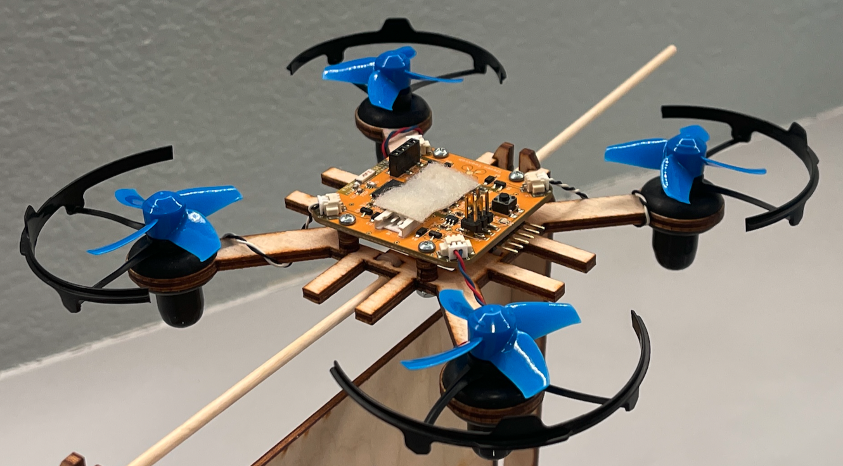
Multirotor Aircraft Components
Airframe
Structural support
Plastic, aluminum, wood, or PCB (fiberglass)
Motors
Lift, movement, and control
Brushed DC motors for small craft
Brushless brushless DC motors for large craft.
Inertial Measurement Unit (IMU)
Sensing the aircraft’s orientation and movement
Gyroscopes and accelerometers.

Slide 4
Multirotor Aircraft Components
Computing resources (microcontroller/processor)
To run the flight control software
Manage communication
Flight control software
Provides stability using the IMU and motors
Converts pilot commands to motor outputs
Radio
For receiving command
Returning telemetry.
Power supply
Lots of power for the motors
Carefully regulated power for the IMU and micro controller.

Slide 5
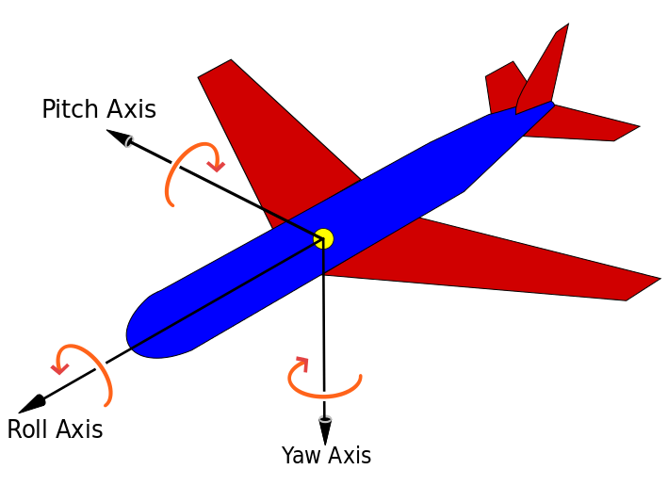
Principle Axes of an Aircraft
Pitch – leaning front or back
Roll -- leaning side to side
Yaw – rotating

Slide 6
Motor Configurations
“multirotor” is more accurate that “quadcopter”
There are always an even number of motors
Half spin clockwise
Half spin counter-clockwise

Slide 7
Controlling Pitch
Pitch forward
More thrust to the rear
Less to the front
Quad moves forward
Pitch backward
Less thrust to the rear
More to the back
Quad moves backward
Net torque is constant

Slide 8
Controlling Roll
Pitch Left
More thrust to the right motor
Less to the left
Quad moves to the left
Pitch Right
More thrust to the left motor
Less to the Right
Quad moves to the right
Net torque is constant

Slide 9
Controlling Yaw
Rotate CCW
More thrust to the CCW motors
Less to the CW
Rotate CW
More thrust CW motors
Less to the CCW
Net thrust is constant

Slide 10
Quadcopters (and the Environment) are Imperfect
Motors are not perfect
Manufacturing differences
Electrical differences
Propeller imperfections
Air currents will move the quadcopter.
Turning on all motors the “same” amount
Leads to imbalanced torque and uneven thrust.
A crash is inevitable
This is “open loop” control

Slide 11
Closing the Loop for Controlled, Stable Flight
Quadcopters sense the orientation
IMU – Inertial Measurement Unit
Measures pitch, roll, and yaw
The flight computer, adjusts motor outputs to achieve a target orientation
Level – stationary flight
Pitched forward – fly forward
etc.
The target can be set via a remote to control flight.

Slide 12

Open vs. Closed Loop Control

Slide 13
In Summary: Flight Requirements and Our Labs
Requirement | Hardware | Software | Manufacturing
Driving the motors | Motors, battery, airframe, etc. Building The Quadcopter Schematic Laying Out The Board | Analog pin output Programming The Hardware
Providing a target orientation (via the remote) | A radio, a remote control Building The Quadcopter Schematic Laying Out The Board | Communication protocol Programming The Hardware
Sensing the quadcopter’s orientation | An IMU Building The Quadcopter Schematic Laying Out The Board | Filter out noise, a little math Sensing and Filtering
Adjusting motor output to achieve the target orientation |  | A clever control algorithm Implementing PID
Stable flight |  | A lot of tuning Flight
Assembled quadcopter |  |  | Tape-out, Assembly, and Bring-up PCB Assembly

Slide 14
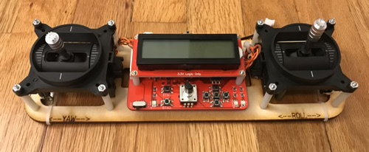
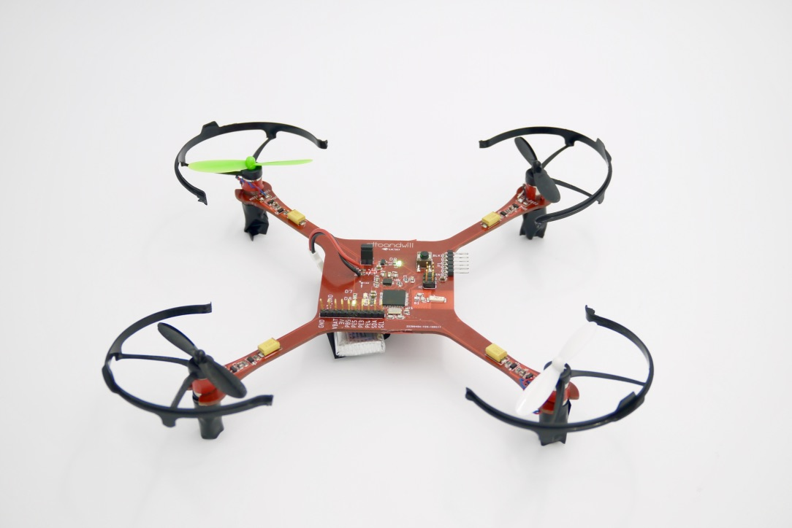
Our Project
Motors
IMU
Radio
Flight control software

Slide 15

The Hardware You will Build

Slide 16
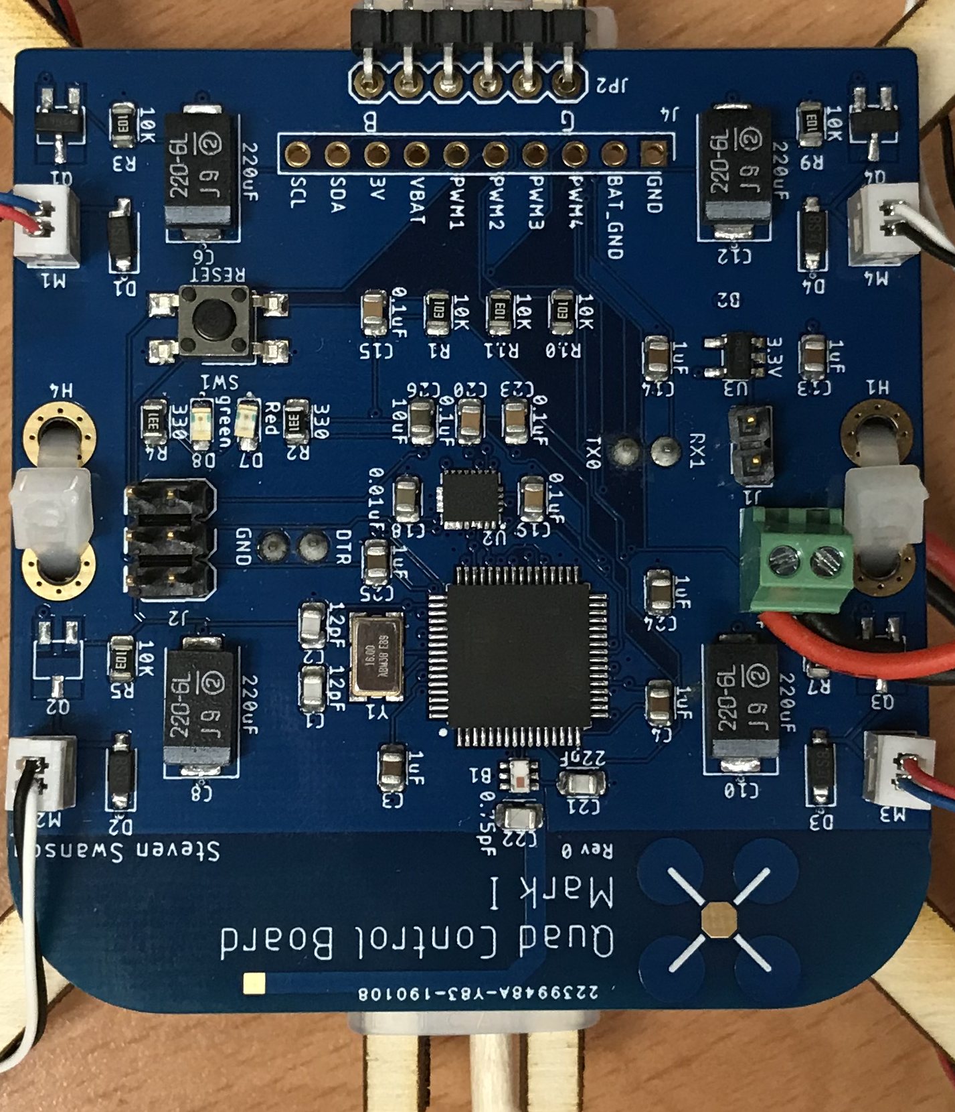
The Hardware You Will Build

Slide 17
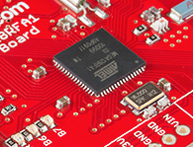
Flight Computer: ATmega128RFA1 microcontroller
Arduino compatible
16Mhz clock
128KB Flash
16KB SRAM
4096B EEPROM
2.4GHz radio

Slide 18
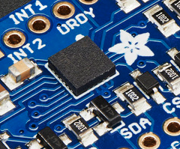
Inertial Measurement Unit
STMicro LSM9DS1
9-axis sensor
3-axis accelerometer
3-axis magnetometer
3-axis gyroscope
I2C interface

Slide 19
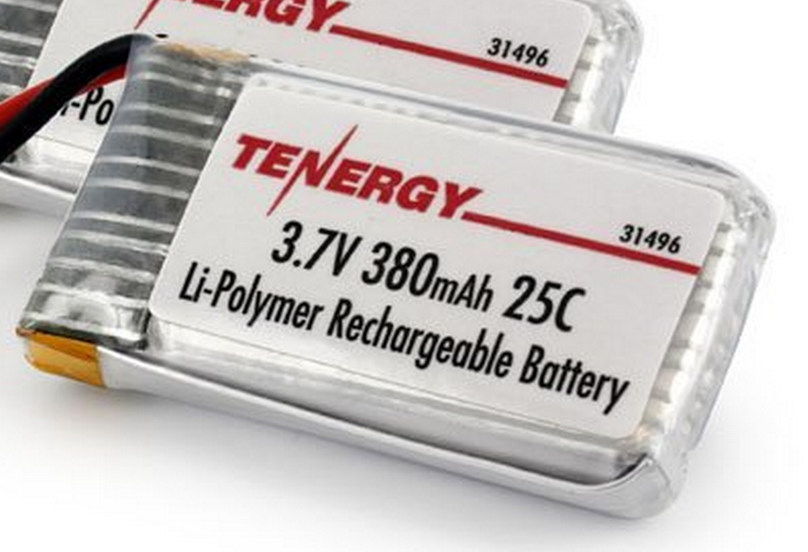
Power Supply
Lithium Polymer Battery
370-600 mAh
Max Current: 9.25 Amps (a lot!)
Nominal voltage: 3.7-4.2V
Powers the motors directly
3.3V low dropout (LDO) voltage regulator
Powers the microcontroller and the IMU

Slide 20
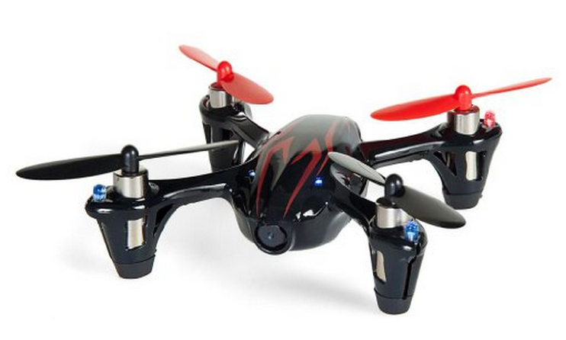
Motors and Props
DC brushed motors
Max current: ~2 Amps
Plenty of power

